Slide 1
B9DA102 Data Storage Solutions for Data Analytics
Prof: Dr. Shazia A Afzal
Name: Ahmed Afzal Khan
Student Number: 10386536

Slide 2
NORTHWIND TRADERS
DATASET ANALYSIS

Slide 3
INTRODUCTION
Considering the Northwind traders dataset two fact tables are being created by fetching the data from different dimension tables.
First for the analysis of northwind traders warehouse total available stock
And other for the analysis of discount on each order.
All these analysis is done by importing the Northwind traders dataset into SQL Server Management Studio and creating a new data warehouse out of it.
ETL process is carried out using Microsoft Visual Studio(SSDT).
XML and XSD schema are being generated to analyse the structure of the data warehouse.
Neo4j is used for Graphical representation of the data warehouse.
Data visualization is done using R Studio.

Slide 4
About Northwind Traders dataset
Northwind dataset is a sample database created by the Microsoft.
It is about imaginary company named ‘Northwind Traders’
Database contains detailed information about:-
Orders, Employees, Suppliers, Customers, Shippers, and Products.

Slide 5
Goals of my Data Warehouse
To calculate the total price of each product’s available stock.
To calculate the total price of each product which is on order from the available stock.
Calculating Discount Price for each Order’s products.
Calculating Discounted Unit Price for each Order’s products.

Slide 6
Data warehouse Diagram

Slide 7
ETL Process
Extract-Transform-Load(ETL) is a process for extracting the data from the data source and transforming the source data as per the desired analysis and then loading the transformed data into the data warehouse. The data warehouse consists of fact and dimension tables.
Each dimension and fact table is loaded using the ETL process in Microsoft Visual Studio(SSDT)
ETL is done by creating SSIS package using Business Intelligence -> Integration Services in Visual Studio
Using OLEDB source for source data and OLEDB destination for the destination table.

Slide 8
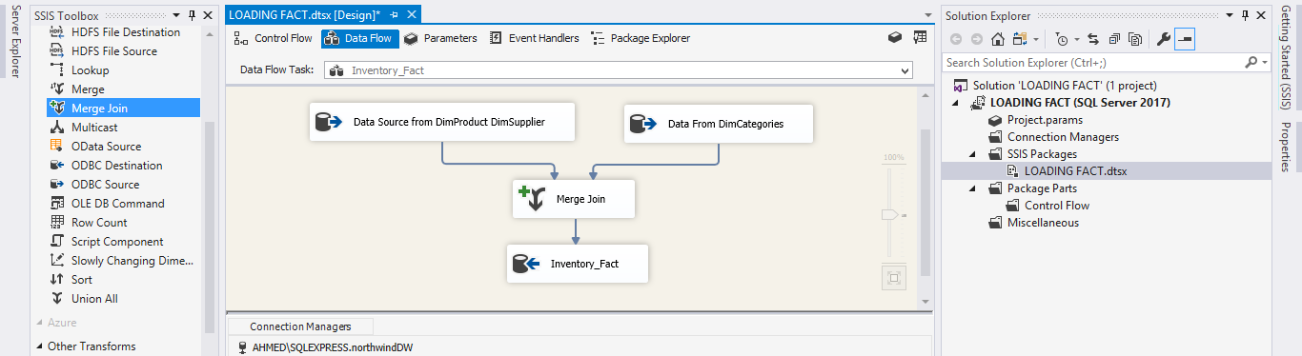
SSIS Package->Data Flow (Inventory)

Slide 9
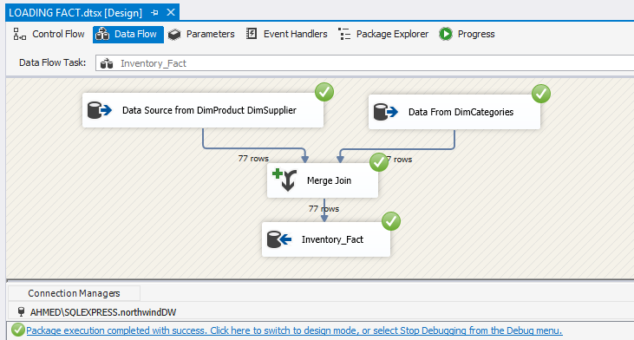
SSIS Package->Data Flow (Inventory)

Slide 10
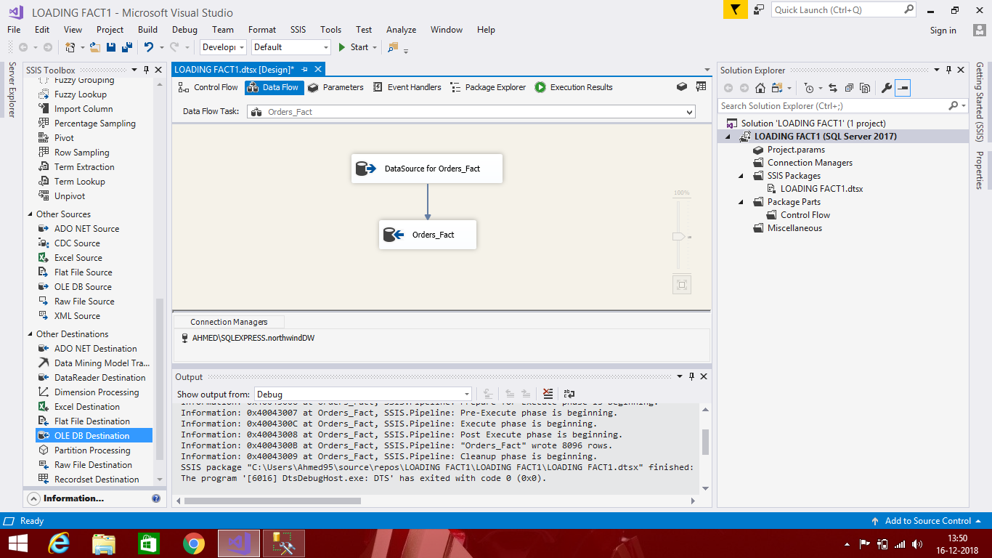
SSIS Package->Data Flow (Orders)

Slide 11
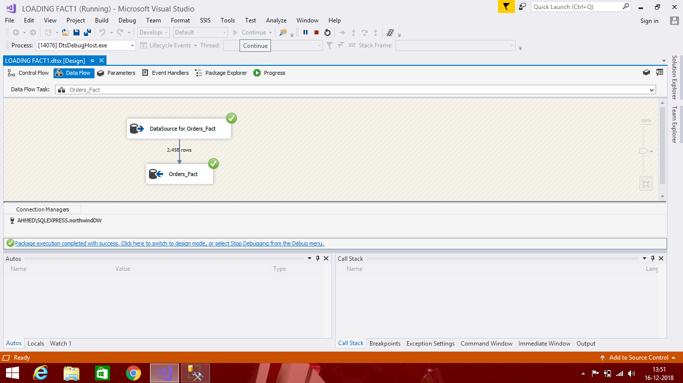
SSIS Package->Data Flow (Orders)

Slide 12
Reporting Services
After transforming and loading the data using ssis package based on our analysis we create reports using SSRS reporting services in Visual Studio.
These reports include the new analysed data from the fact and dimension tables
Here for the Northwind Traders Data warehouse four reports are being created for the two fact tables that is Inventory and Orders Fact tables.

Slide 13
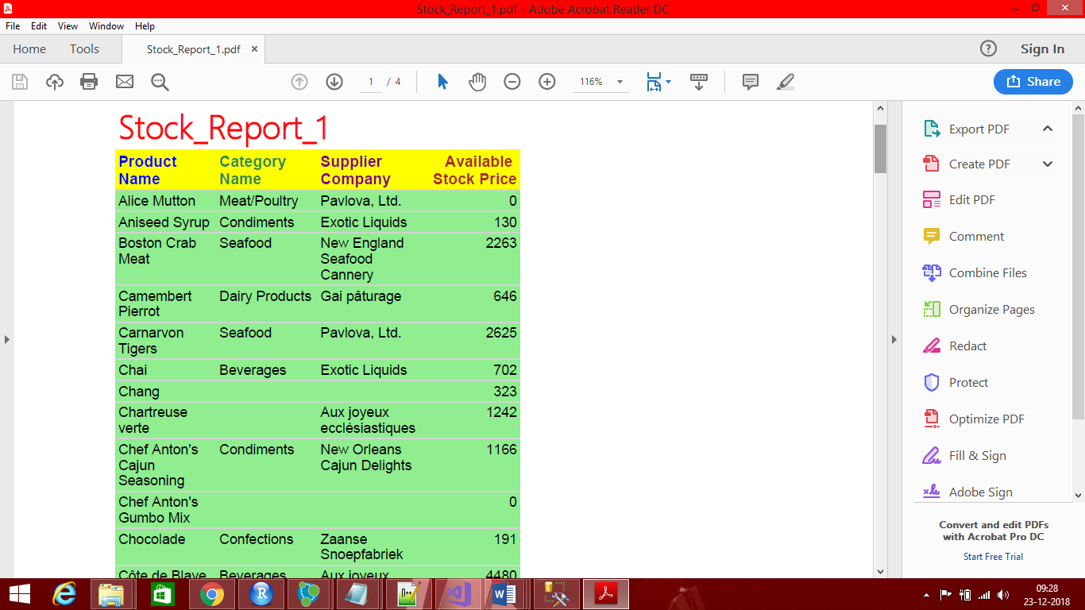
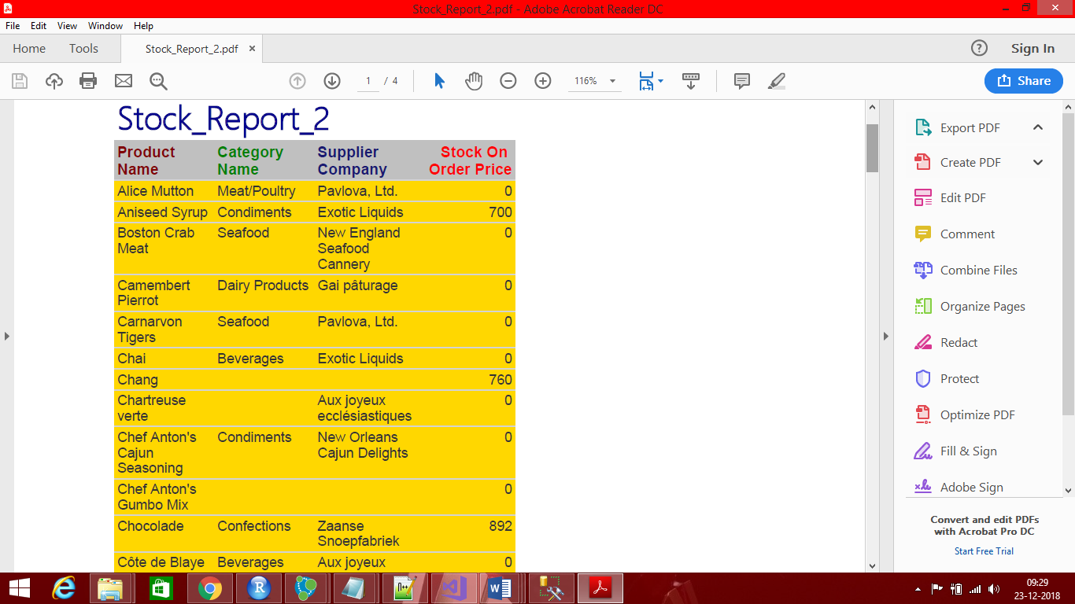
SSRS Reports(Inventory)

Slide 14
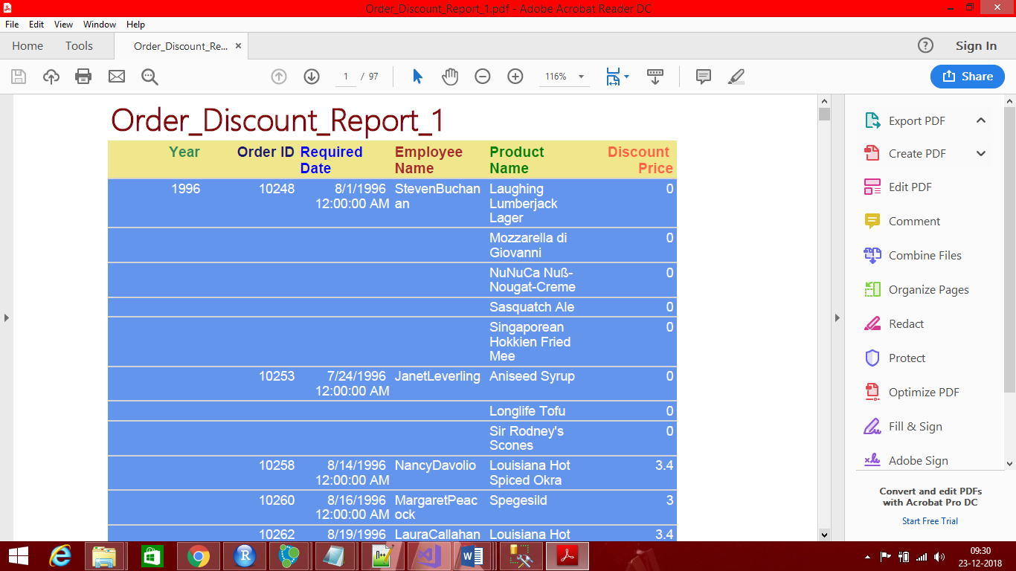
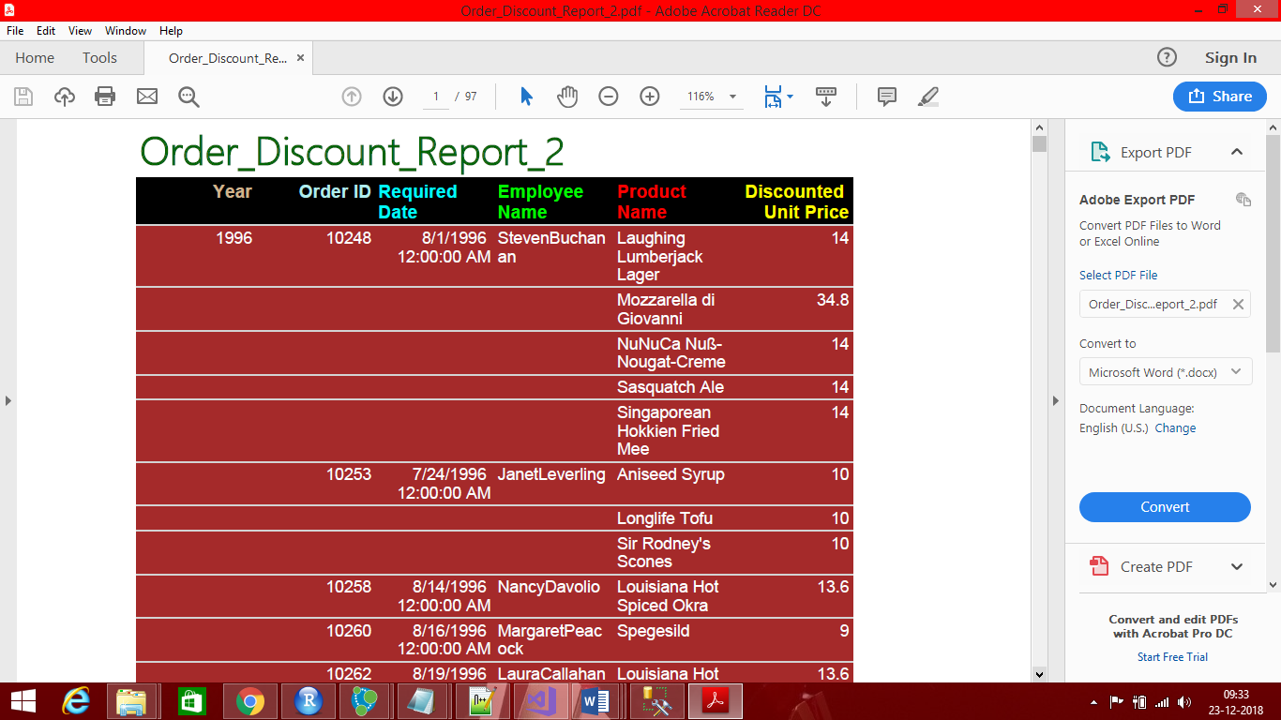
SSRS Reports(Orders)

Slide 15
Data Visualization using R
For visualizing the analysis done on the data we use R studio.
Using R Studio we have to establish a connection to the data warehouse database
And selecting one or more then one table from where data is to be visualized.

Slide 16
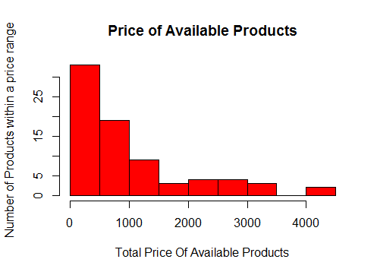
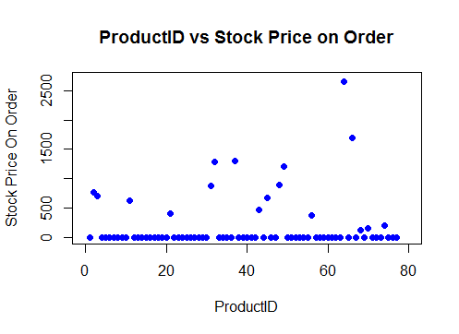
R Visualization for Inventory

Slide 17
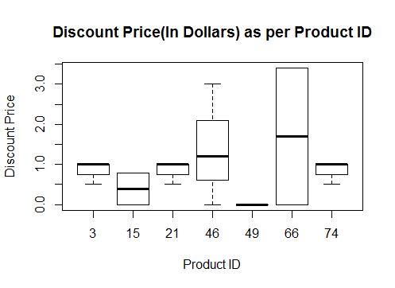
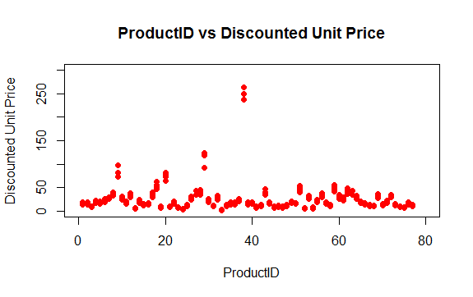
R Visualization for Orders

Slide 18
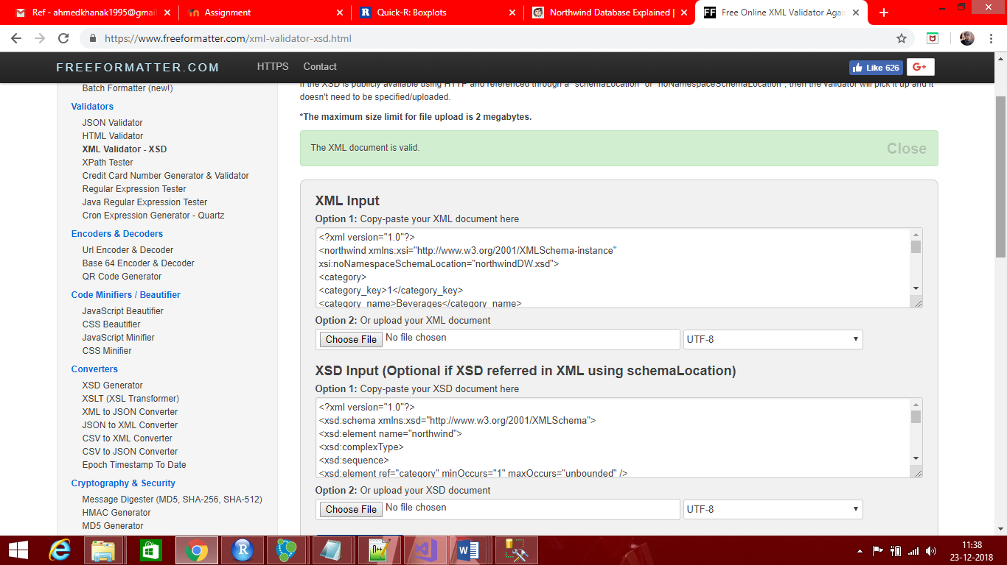
XML and XSD Schema Validation

Slide 19
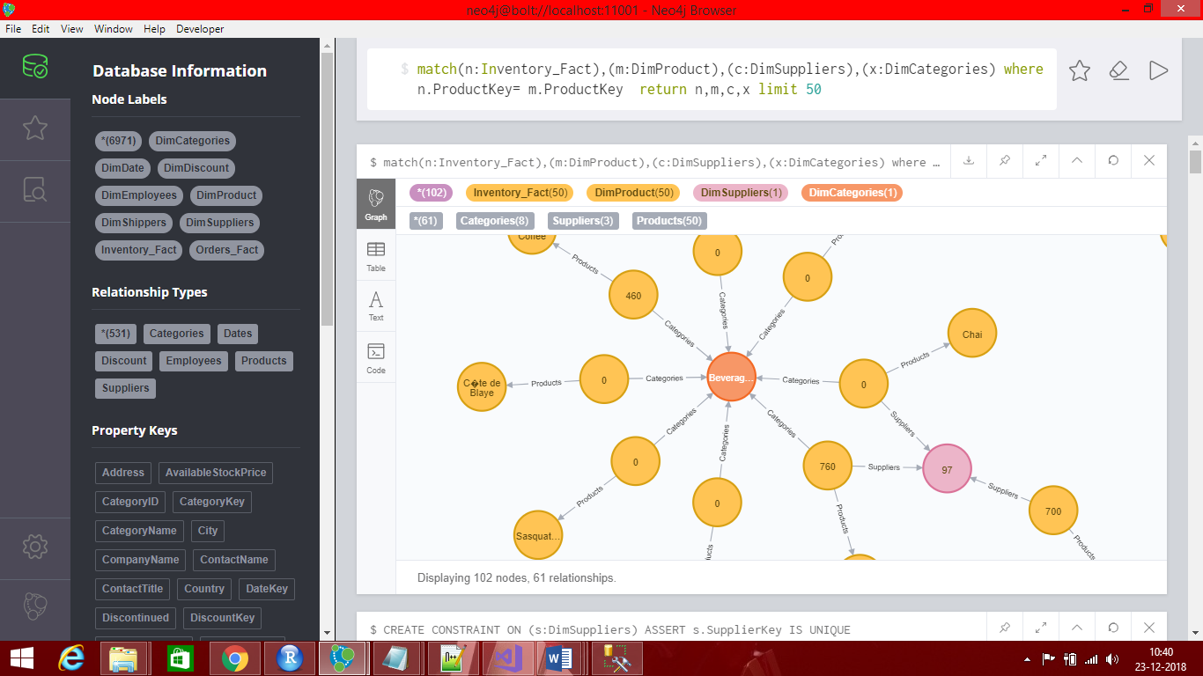
Graphical Representation using Neo4j

Slide 20
References
SQL Server-DataWarehousing[Online].Available:https://www.microsoft.com/enus/
businessimpactinc.com.(2018).Datasets.[online] Available at:https://www.businessimpactinc.com/blog/install-northwind-database/
Neo4j Graph Database Platform. (2018). The Neo4j Graph Platform – The #1 Platform for Connected Data. [online] Available at:https://neo4j.com/

Slide 21
THANK YOU

